Slide 1
Developing a dbplyr-based Address Matching Package
Adnan Shroufi
Data Science Team NHSBSA
NHS-R Conference November 2022

Slide 2
Contents
Introduction
The Package
Use Case
Next Steps

Slide 3
Contents
Introduction
The Package
Use Case
Next Steps

Slide 4
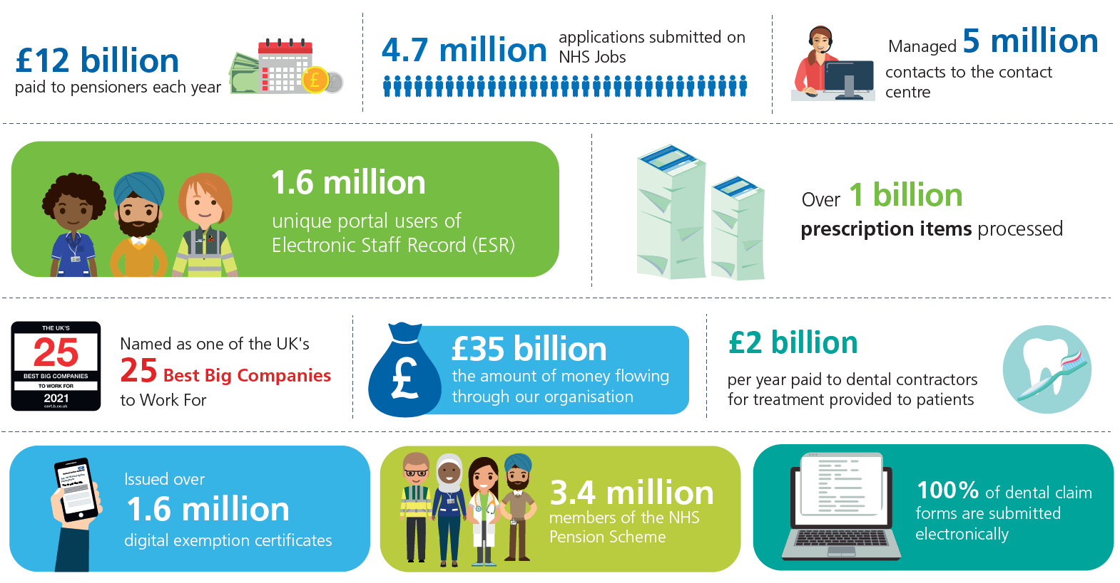
1. Introduction – The NHS Business Services Authority
Arms length body of the DHSC
We deliver new insights from data through innovation, experimentation and collaboration.

Slide 5

1. Introduction - The Problem
Address records can be spelt (or misspelt) in multiple ways across multiple systems
We often want to know which records are likely to be the same despite spelling variations
If repeated often, this can be a time-consuming task
Address matching is often done at scale, for example using Ordnance Survey AddressBase

Slide 6

1. Introduction – What is dbplyr?
A package enabling users to use remote database tables as if in-memory dataframes, by converting dplyr code into SQL
This means a database can be queried using succinct dplyr R-code
Results can be pushed back to the DB or collected locally
R Code | Generated SQL Code
data %>% group_by(var1) %>% summarise(avg = mean(var2) %>% arrange(desc(var1)) | SELECT var1, AVG(var2) AS avg FROM data GROUP BY var1 ORDER BY var1 DESC

Slide 7
1. Introduction - dbplyr Benefits & Considerations
Benefits | Considerations
Write functions in easier-to-read dplyr rather than PLSQL A means of integrating an SQL and R script into a single R script | You cannot do anything that cannot be replicated in SQL Available functions depend on the version of SQL used

Slide 8
Contents
Introduction
The Package
Use Case
Next Steps

Slide 9
2. The Package – Candidate Matches
Records are only matched against addresses sharing the same postcode.
AddressBase Address | AddressBase Postcode | AddressBase Classification
1 Wellfield Close Hatfield | AL100BU | Self-Contained Flat
2 Wellfield Close Hatfield | AL100BU | Self-Contained Flat
3 Wellfield Close Hatfield | AL100BU | Self-Contained Flat
4 Wellfield Close Hatfield | AL100BU | Self-Contained Flat
5 Wellfield Close Hatfield | AL100BU | Self-Contained Flat
… | … | …
33 Wellfield Close Hatfield | AL100BU | Self-Contained Flat
Quantum Care Ltd Greenacres Wellfield Close Hatfield | AL100BU | Care / Nursing Home
Patient Address | Patient Postcode
Greenacres Caring Home Willfield Close Hatfield | AL100BU
Notes:
Hatfield - Hertfordhsire

Slide 10
2. The Package – Best Match
Using tokenised Jaro-Winkler scores, the best matched is identified.
 | Quantum | Care | Ltd | Greenacres | Wellfield | Close | Hatfield
Greenacre | 0 | 0. | 0 | 0.97 | 0 | 0 | 0
Caring | 0 | 0.83 | 0 | 0 | 0 | 0 | 0
Home | 0 | 0 | 0 | 0 | 0 | 0 | 0
Willfield | 0 | 0 | 0 | 0 | 0.93 | 0 | 0
Close | 0 | 0 | 0 | 0 | 0 | 1 | 0
Hatfield | 0 | 0 | 0 | 0 | 0 | 0 | 1
Matching: Greenacres Caring Home Willfield Close Hatfield
To: Quantum Care Ltd Greenacres Wellfield Close Hatfield
Score: 4.73 / 6 = 79%
 | 4 | Wellfield | Close | Hatfield | Herts
Greenacre | 0 | 0. | 0 | 0 | 0
Caring | 0 | 0 | 0 | 0 | 0
Home | 0 | 0 | 0 | 0 | 0
Willfield | 0 | 0.93 | 0 | 0 | 0
Close | 0 | 0 | 1 | 0 | 0
Hatfield | 0 | 0 | 0 | 1 | 0
Matching: Greenacres Caring Home Willfield Close Hatfield
To: 4 Wellfield Close Hatfield Herts
Score: 2.93 / 6 = 49%

Slide 11
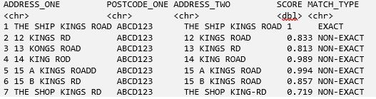
2. The Package - Considerations
Incorrect or non-Existent Postcodes
Oracle database configured code
Output validation and match score threshold
Manual handling of join top scoring matches

Slide 12
Contents
Introduction
The Package
Use Case
Next Steps

Slide 13
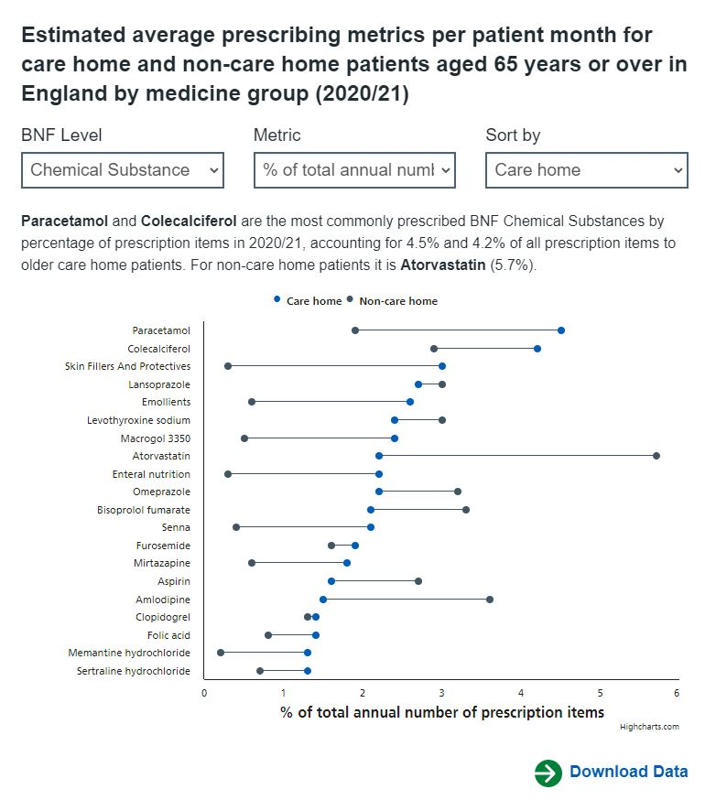
3. Use Case – Classifying Care Home Prescription Forms
257m prescription forms for patients aged 65 or over in the 20/21 financial year were matched against 32m Ordnance Survey AddressBase records.
The AddressBase building classification, 16m of these forms (35m items) were matched to a care home.
The estimated form-level matching accuracy was 99.7%. Sometimes over 100 differently spelt addresses could be matched to the same address.
The matching enabled the most detailed analysis of care home prescribing to date.

Slide 14
Contents
Introduction
The Package
Use Case
Next Steps

Slide 15
4. Next Steps
Step | Link
Use Case | Estimated prescribing patterns for care home patients aged 65 years or over (shinyapps.io)
Blog | A dbplyr-based Address Matching Package – NHS-R Community (nhsrcommunity.com)
Code | addressMatchR/R at master · nhsbsa-data-analytics/addressMatchR (github.com)
OS AddressBase | AddressBase | OS Products (ordnancesurvey.co.uk)
Contact | nhsbsa.datalab@nhs.net

Slide 16
Developing a dbplyr-based Address Matching Package
Adnan Shroufi
Data Science Team NHSBSA
NHS-R Conference November 2022

